Slide 1

Software Engineering
Introduction to Software Engineering
Acknowledgement: Authors of the prescribed textbooks and materials sourced online.

Slide 2

List of Contents
Requirement Specification
Documentation Characteristics
SRS
Requirement Validation
Requirement Management
RTM
Requirement Change Management

Slide 3
Requirements Specification
Once requirements are elicited, analyzed, we then specify those requirements..
Requirements specification is the documentation of a set of requirements that is reviewed and approved by the customer and provides direction for the software construction activities in the next stage of the life cycle
The software requirements specification (SRS) document is the basis for customers and contractors/suppliers agreeing on what the product will and will not do. It describes both the functional and nonfunctional requirements

Slide 4
Documentation Characteristics
Reasons for documentation
Characteristics of documentation
Visibility
Accurate and kept current
Formalization leads to better clarity
Appropriate for audience
User support
Maintained online
Team communication
Simple but professional in style and appearance
Maintenance and evolution

Slide 5
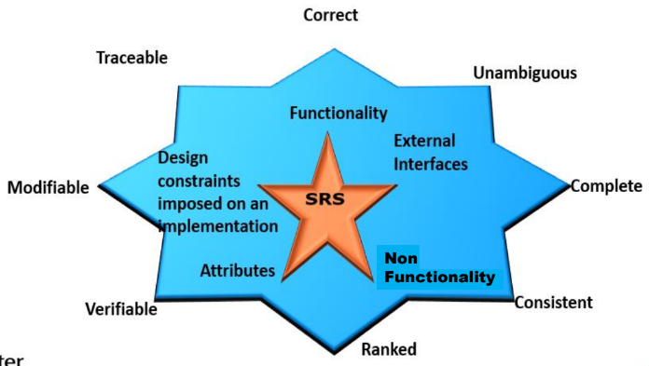
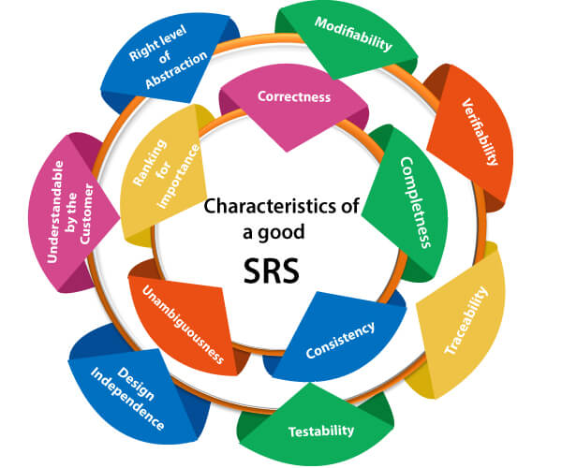
Requirement Specification

Slide 6
Software Requirement Specification (SRS)
Functionality: What is the software supposed to do?
External interfaces: How does the software interact with people, the system’s hardware,
other hardware, and other software?
Non Functionality: This includes all of the Quality criteria which drive the functionality. Example: Performance, Availability, Portability etc.
Design constraints imposed on an implementation:
▪ Required standards in effect
▪ Implementation language
▪ Policies for database integrity
▪ Resource limits
▪ Security
▪ Operating environment(s) etc.

Slide 7
An example of Software Requirement Specification (SRS)
ToC recommended by IEEE for SRS (IEEE Std. 830-1998)
1. Introduction
1.1 Purpose
1.2 Scope
1.3 Definitions, acronyms, and abbreviations
1.4 References
1.5 Overview
2. Overall description
2.1 Product perspective
2.2 Product functions
2.3 User characteristics
2.4 Constraints
2.5 Assumptions and dependencies
3. Specific requirements
3.1 External Interface
3.2 Functional Requirements
3.3 Non-Functional Requirements
3.4 Design Constraints
Appendixes
Index

Slide 8

Requirement Validation
The purpose of requirements is to help ensure that the requirements does what
the customer wants. This is an important phase because repairing requirement errors in downstream phases can be expensive.
VALIDATION & VERIFICATION
Validation determines whether the software requirements if implemented, will solve the right problem and satisfy the intended user needs
Verification determines whether the requirements have been specified correctly
(Reviews are used for both validation and verification)

Slide 9
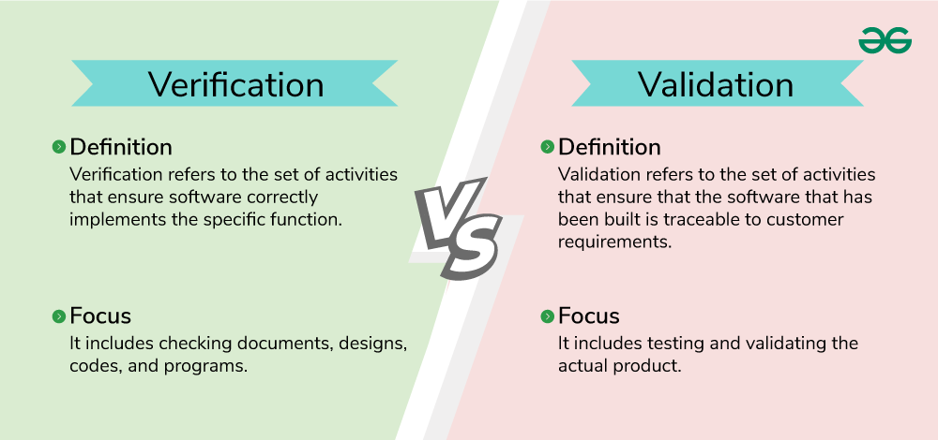
Verification VS Validation

Slide 10
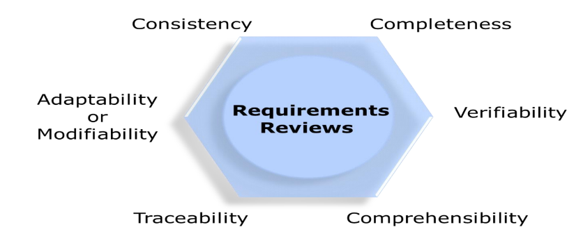
Requirement Validation
Requirement Reviews

Slide 11
Requirement Validation
Prototyping
Prototype facilitates user involvement during requirements engineering phase and ensures engineers and users have the same interpretation of the requirements.
Prototyping is most beneficial in systems – With many user interactions
Example: Design of online billing systems
Systems with little or no user interaction may not benefit as much from prototyping
Example: Batch processing
Model Validation
Ensuring that the models represent all essential functional requirements
Demonstrating that each model is consistent in itself
Usage of the Fish Bone Analysis technique for validation
Acceptance Criteria
To check if there are requirements matching with that the Acceptance criteria

Slide 12
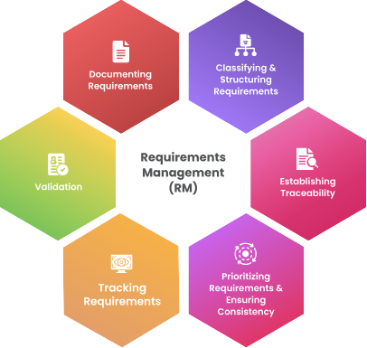
Requirement Management
Link : https://analysttool.com/requirements-management-vs-requirements-engineering

Slide 13
Requirements Management
Requirements specification is the baseline on which the future lifecycle phases will need to build upon
Can you think of reasons why requirements might change?
Better understanding of the problem
Customer internalizing the problem and solution
Evolving environment and technology landscape
Ensuring that the requirements are all addressed in each phases of the lifecycle
Facets of Requirements Management
Ensuring that the changes in the requirements are handled appropriately

Slide 14
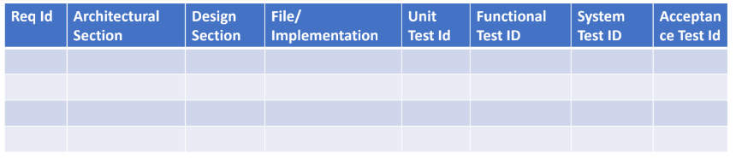
Requirements Traceability Matrix – RTM
Requirements are traced across the SDLC using the requirement traceability matrix (RTM)
▪ Forward Tracing
▪ Backward Tracing
Every phase of the SDLC progressively fills the RTM
Link : https://www.geeksforgeeks.org/requirement-traceability-matrix/

Slide 15
Requirement Change Management
Change in the requirements have impacts on plans, work products etc.
Uncontrolled changes can have a huge adverse impact on project in terms of cost, schedule, quality and expectations/
In the perspective of managing the changes, change requests go through a formal change management process.
REQUIREMENT CHANGE PROCESS
Log the request for change and assign a change request Identifier
Log
▪ Who is requesting the change
▪ Why is the request coming in
▪ What is being requested to change
Perform impact analysis & estimate impact.
Review impact with stakeholders
Log the following post changes
▪ When was it changed
▪ Who all made changes
▪ Who reviewed the changes
▪ Who tested the changes
▪ Which release stream is the change going
to be part of
Rework the work products/items
Solicit Formal Approval as part of the approval process

Slide 16
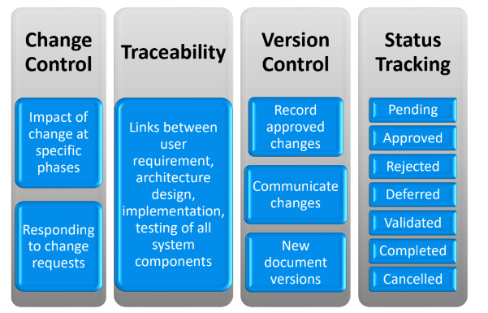

Requirement Change Management

Slide 17
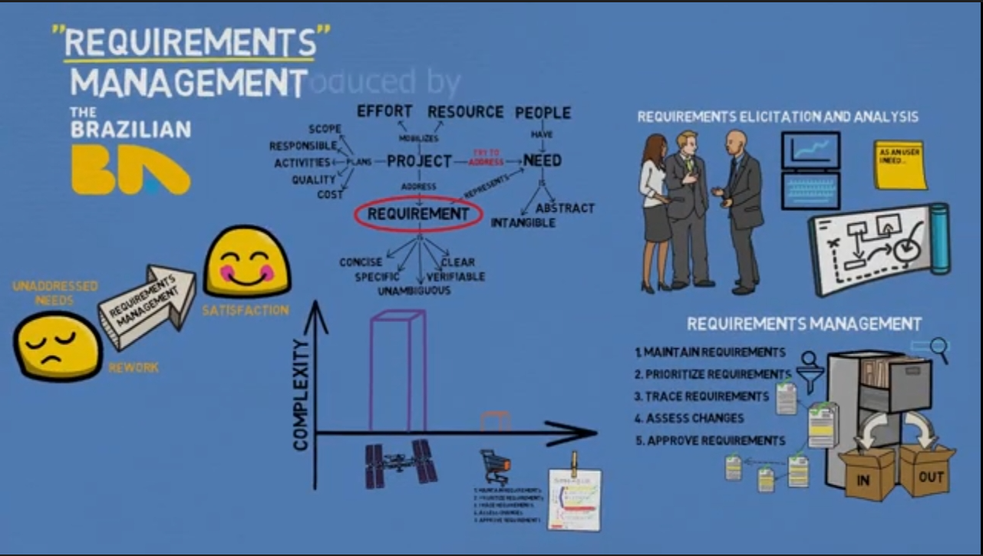
Requirement Engneering and Management

Slide 18
THANK YOU

